Slide 1

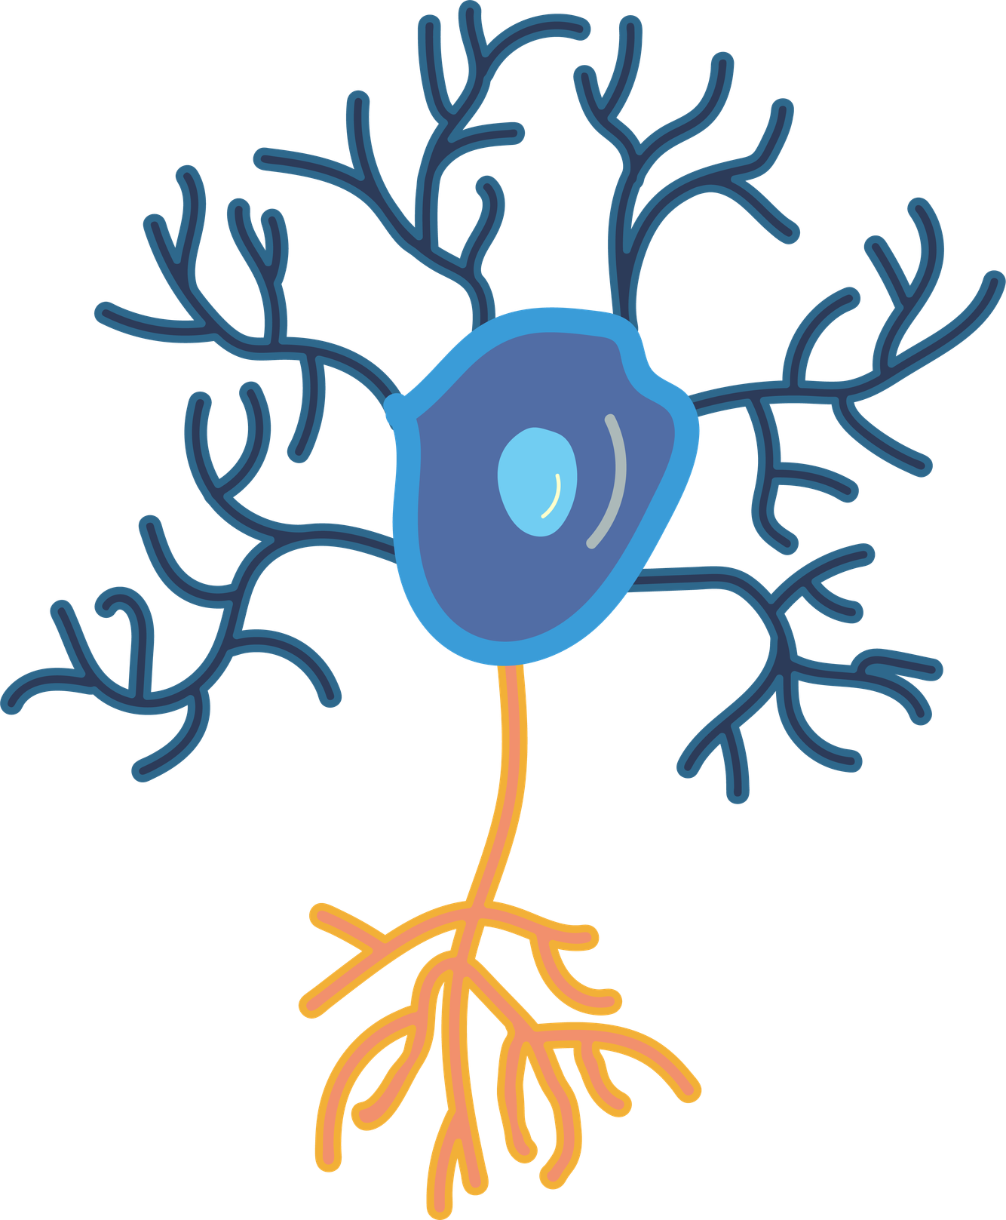

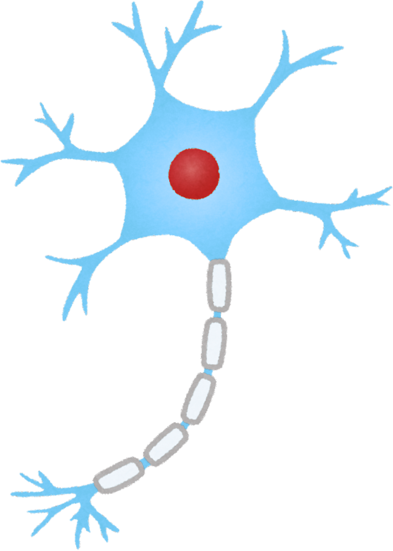
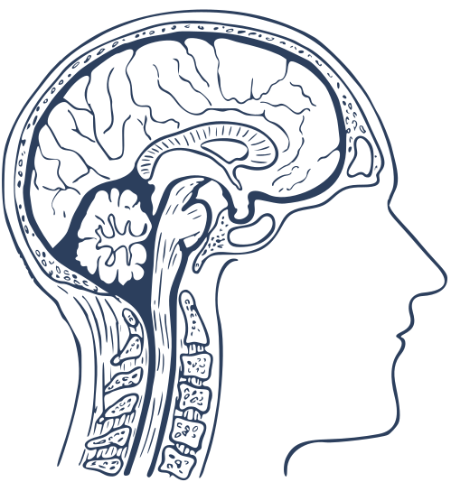

Smell and Memory
Presented by:Hadade Dragos

Slide 2
Smell and the brain
Smell is different from the other senses because it goes directly to the parts of the brain that control memory and emotions. When we smell something, the information does not need much processing. This is why memories connected to smell appear very fast and feel very natural.

Slide 3
Smell and emotions
Smells are often linked to strong emotions such as happiness or sadness. When emotions are involved, the brain stores the memory more deeply. Because of this, memories created with smells are usually more powerful and easier to remember than normal memories.The smell of coffee in the morning can make you feel calm and ready for the day.

Slide 4
Long-term memory
Smell memories can last many years. Even after a long time, a familiar smell can bring back clear memories of places, people, or moments from the past. These memories often feel very real and detailed, because smell is strongly connected to memory areas in the brain.The smell of freshly baked bread can remind you of family meals or home.

Slide 5
Smell and learning
Smell can also play a role in learning and remembering information. If the same smell is present while studying and later when trying to remember, the brain can recall the information more easily. This shows that smell can support memory in everyday situations.Chewing mint gum while studying and then chewing the same gum during a test can help you remember the material better.

Slide 6
Conclusion
Smell is a powerful sense directly connected to the parts of the brain that control memory and emotions. It can trigger long-term memories that stay with us for many years and make experiences feel more real. Smell also influences the way we feel and can strengthen emotional connections to memories.Overall, the sense of smell plays an important role in how we understand, remember, and experience the world around us.

Slide 7
Webography
  https://www.sciencedaily.com/releases/2021/03/210308140743.htm
  https://news.northwestern.edu/stories/2021/03/why-odors-trigger-powerful-memories?
  https://magazine.hms.harvard.edu/articles/connections-between-smell-memory-and-health
  https://health.clevelandclinic.org/smells-and-memory

Slide 8
Thank You

